Slide 1
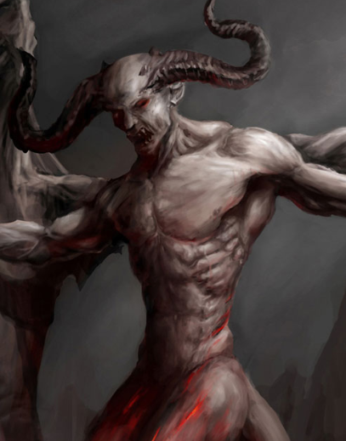
Is Satan Real? Exploring Scriptures & Life of the Saints
Auxilium Website
April 2024
Christopher Thnay-Hu

Slide 2
Who is Satan?
He comes by many names:
Devil
Demon (Greek)
Lucifer (Light Bearer – before his fall)
Beelzebul, prince of demon (Lord of the flies)
Unclean spirits
The Tempter
A liar, father of lies
The prince and power of the air
A roaring lion (I Pt 5:8)
The Dragon, ancient serpent (Gn 3:15)

Slide 3
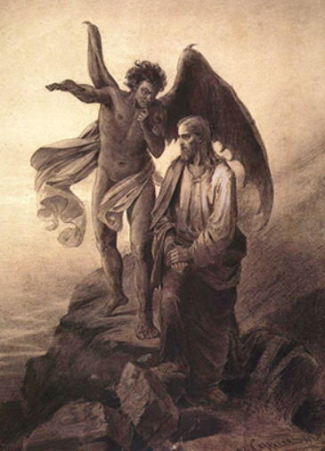
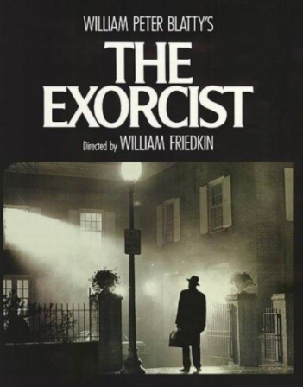
How does the Devil work?
Make people not believe he exists!
Temptations:
Deceptions – OK to sin, everyone does – just do it
False accusations – you are no good, no body cares about you.
Enticements – what you see, hear and taste
Rare Cases:
Possessions
- True story behind the Exorcist

Slide 4
What does the Bible Say?
The seventy-two returned with joy and said, “Lord, even the demons submit to us in your name.”
He replied, “I saw Satan fall like lightning from heaven. I have given you authority to trample on snakes and scorpions and to overcome all the power of the enemy; nothing will harm you. However, do not rejoice that the spirits submit to you, but rejoice that your names are written in heaven.” (Luke 10 )
Just then a man in their synagogue who was possessed by an impure spirit cried out, ²⁴ “What do you want with us, Jesus of Nazareth? Have you come to destroy us? I know who you are—the Holy One of God!” “Be quiet!” said Jesus sternly. “Come out of him!” The impure spirit shook the man violently and came out of him with a shriek. (Mark 1:23-28)

Slide 5
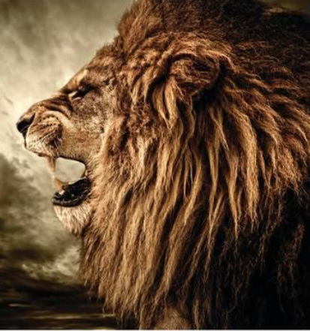
Be alert and of sober mind. Your enemy the devil prowls around like a roaring lion looking for someone to devour. 9 Resist him, standing firm in the faith, because you know that the family of believers throughout the world is undergoing the same kind of sufferings. (1 Peter 5:8)

Slide 6
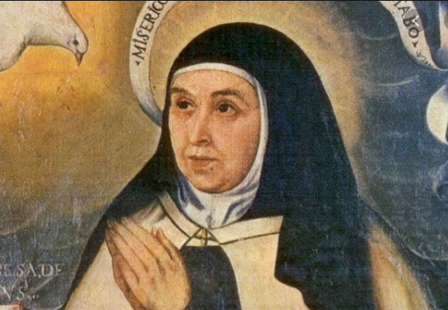
The devil in life of the saints
What is a witness?
Trustworthiness
Reliability
St Teresa of Avila:
Another time, not long ago, the same thing happened to me; although it didn't last as long, and I was alone. I called for holy water, and those who entered after the devil had already gone (for they were two nuns well worthy of belief, who would by no means tell a lie) smelled a foul stench like that of brimstone.
Also one night during this time I thought they were choking me; after much holy water had been sprinkled around, I saw a great multitude of them go by, as though they were being thrown down a precipice. There are so many times that these cursed creatures torment me, and so little is the fear I now have of them, seeing that they cannot stir unless the Lord allows them, that I would tire your Reverence and tire myself if I told about all these instances.

Slide 7
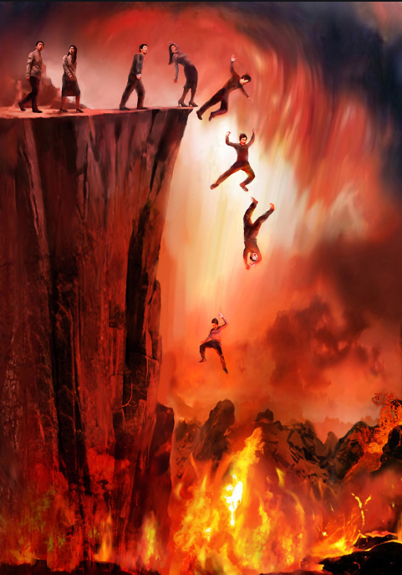
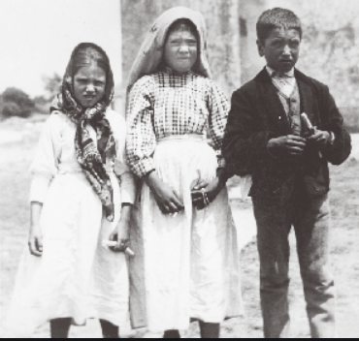
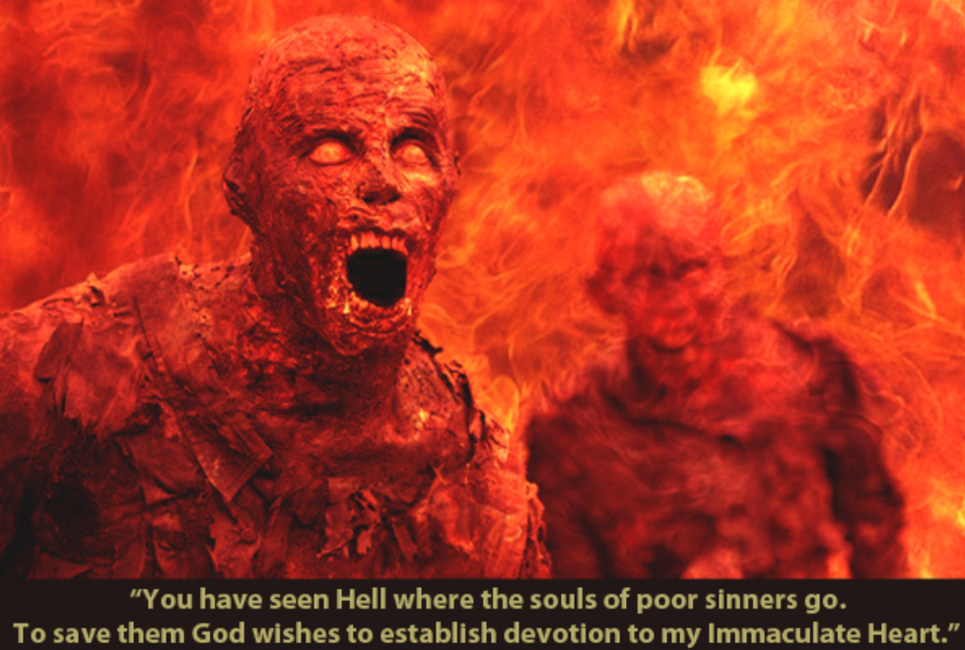
Does Hell Exists?
Our Lady of Fatima
1917

Slide 8
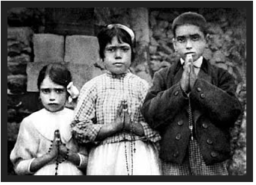
Vision of Hell The rays of light seemed to penetrate the earth, and we saw as it were a sea of fire. Plunged in this fire were demons and souls in human form, like transparent burning embers, all blackened or burnished bronze, floating about in the conflagration, now raised into the air by the flames that issued from within themselves together with great clouds of smoke, now falling back on every side like sparks in huge fires, without weight or equilibrium, amid shrieks and groans of pain and despair, which horrified us and made us tremble with fear. (It must have been this sight which caused me to cry out, as people say they heard me). The demons could be distinguished by their terrifying and repellent likeness to frightful and unknown animals, black and transparent like burning coals.

Slide 9
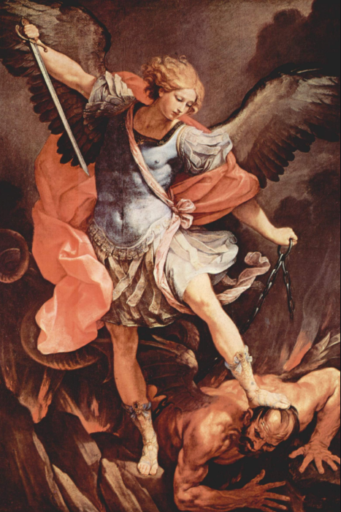
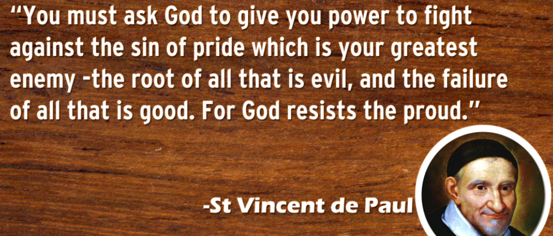
Weapons for the Battle?
Sacraments and Sacramentals
Eucharist
Confessions
Prayers and Rosary
Prayer – lifting up the mind and heart.
- Mental and vocal – learn the Our Father
- eg. Daily time to connect with God the father - John the milkman
Holy Water
Sign of the cross
God’s Word:
“Jesus answered, “It is written: ‘Man shall not live on bread alone, but on every word that comes from the mouth of God” (Mt 4:4)

Slide 10
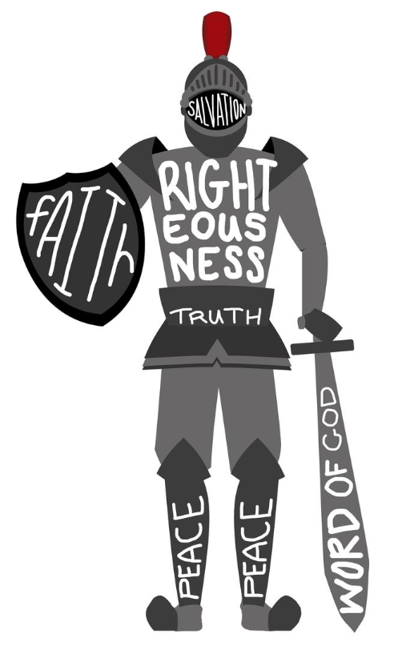
The Armor of God
¹⁰ Finally, be strong in the Lord and in his mighty power. ¹¹ Put on the full armor of God, so that you can take your stand against the devil’s schemes. ¹² For our struggle is not against flesh and blood, but against the rulers, against the authorities, against the powers of this dark world and against the spiritual forces of evil in the heavenly realms.
Therefore put on the full armor of God, so that when the day of evil comes, you may be able to stand your ground, and after you have done everything, to stand.
¹⁴ Stand firm then, with the belt of truth buckled around your waist, with the breastplate of righteousness in place,
¹⁵ and with your feet fitted with the readiness that comes from the gospel of peace.
¹⁶ In addition to all this, take up the shield of faith, with which you can extinguish all the flaming arrows of the evil one.
¹⁷ Take the helmet of salvation and the sword of the Spirit, which is the word of God. (Ephesians 6:10-18)

Slide 11
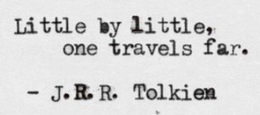
Living as a Child of God
Therefore God exalted him to the highest place
and gave him the name that is above every name,
that at the name of Jesus every knee should bow,
in heaven and on earth and under the earth,
and every tongue acknowledge that Jesus Christ is Lord. (Philippians 2:10)
"The angel of the Lord is encamped around those who revere him and rescues them." (Psalm 34:7)
Once Padre Pio asked a man to select a name for his guardian angel. "Pick a name for your guardian angel and call him by that name always"

Slide 12
St Michael
Saint Michael the Archangel, defend us in battle.
Be our protection against the wickedness and snares of the devil;
May God rebuke him, we humbly pray;
And do thou, O Prince of the Heavenly Host, by the power of God, thrust into hell Satan and all evil spirits who wander through the world for the ruin of souls. Amen

Slide 13
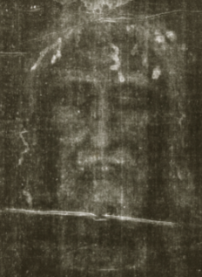
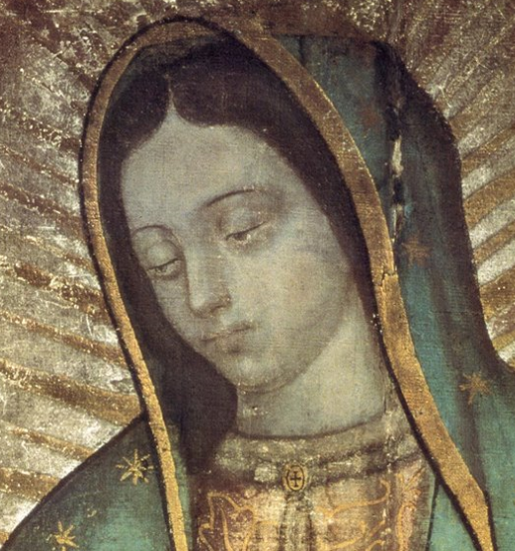
Morning Offering
Dearest Mother Mary, I offer myself entirely to you, and in proof of my filial affection I offer to you this day my eyes, my ears, my tongue, my heart, in a word, my whole self. Now that I am entirely yours Mother of goodness, keep me and defend me as your own property and possession. Amen
Obedience
Listen, my son, to your father’s instruction and do not forsake your mother’s teaching. 9 They are a garland to grace your head and a chain to adorn your neck. (Proverbs 1:8-9) Children, obey your parents in the Lord, for this is right. 2 “Honor your father and mother”—which is the first commandment with a promise— 3 “so that it may go well with you and that you may enjoy long life on the earth.” (Ephesians 6:1-3)
Daily Examination of Conscience
1. Thanksgiving Lord, I realize that all, even myself, is a gift from you. Today, for what things am I most grateful? 2. Examination Lord, show me what I have done well and what I need to improve. For what I have done well – be thankful For those I have done badly, show me. 3. Contrition Lord, I am sorry for the wrong I have done and good that I have failed to do. 4. Resolution Help me to be better tomorrow. Amen
Prayer to Saint Michael
Saint Michael the Archangel, defend us in battle. Be our protection against the wickedness and snares of the devil; May God rebuke him, we humbly pray; And do thou, O Prince of the Heavenly Host, by the power of God, thrust into hell Satan and all evil spirits who wander through the world for the ruin of souls. Amen

Slide 14
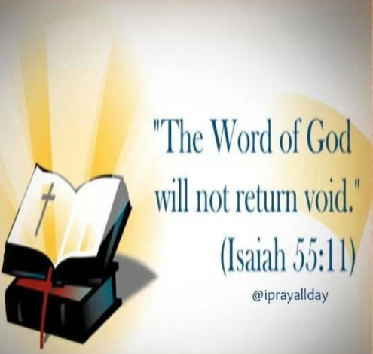
As the rain and the snow come down from heaven, and do not return to it without watering the earth and making it bud and flourish, so that it yields seed for the sower and bread for the eater, so is my word that goes out from my mouth: It will not return to me empty, but will accomplish what I desire and achieve the purpose for which I sent it. (Isiah 55:10-11)

Slide 15
Immaculate Mary Immaculate Mary, your praises we sing. You reign now in Heaven with Jesus our King. Ave, Ave, Ave, Maria! Ave, Ave, Ave, Maria! In Heaven the blessed your glory proclaim; On earth we your children invoke your sweet name. Ave, Ave, Ave, Maria! Ave, Ave, Ave, Maria! We pray for our Mother, the Church upon earth, And bless, Holy Mary, the land of our birth. Ave, Ave, Ave, Maria! Ave, Ave, Ave, Maria!

Slide 16
